Slide 1
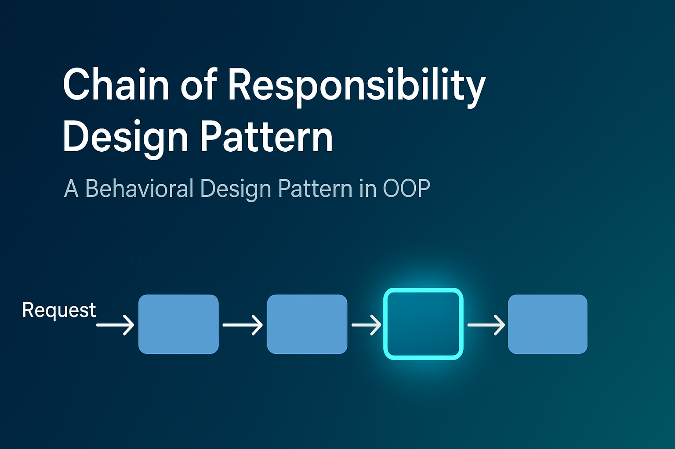

Slide 2
Creational (5)
Factory
Structural (7)
Adapter
Behavioral (11)
Chain Of Responsibility
Abstract Factory
Singleton
Prototype
Builder
Bridge
Composite
Decorator
Facade
Flyweight
Proxy
Command
Interpreter
Iterator
Mediator
Memento
Observer
State
Strategy
Template
Visitor

Slide 3
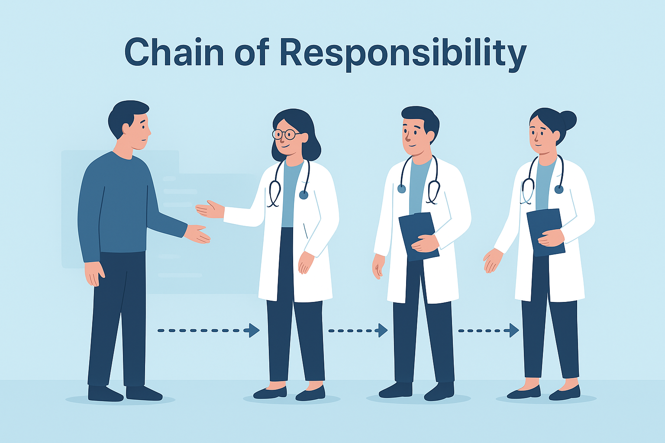

Slide 4
Chain of Responsibility Pattern
A Behavioral pattern
Avoid coupling the sender of a request to its receiver by giving more than one object to handle request.
Chain the receiving objects and pass the request along the chain until an object handles it.
Ex: Consulting a doctor.
The processing chain may end in either of these two scenarios:
A handler can process the request completely.
You have reached the end of the chain.

Slide 5
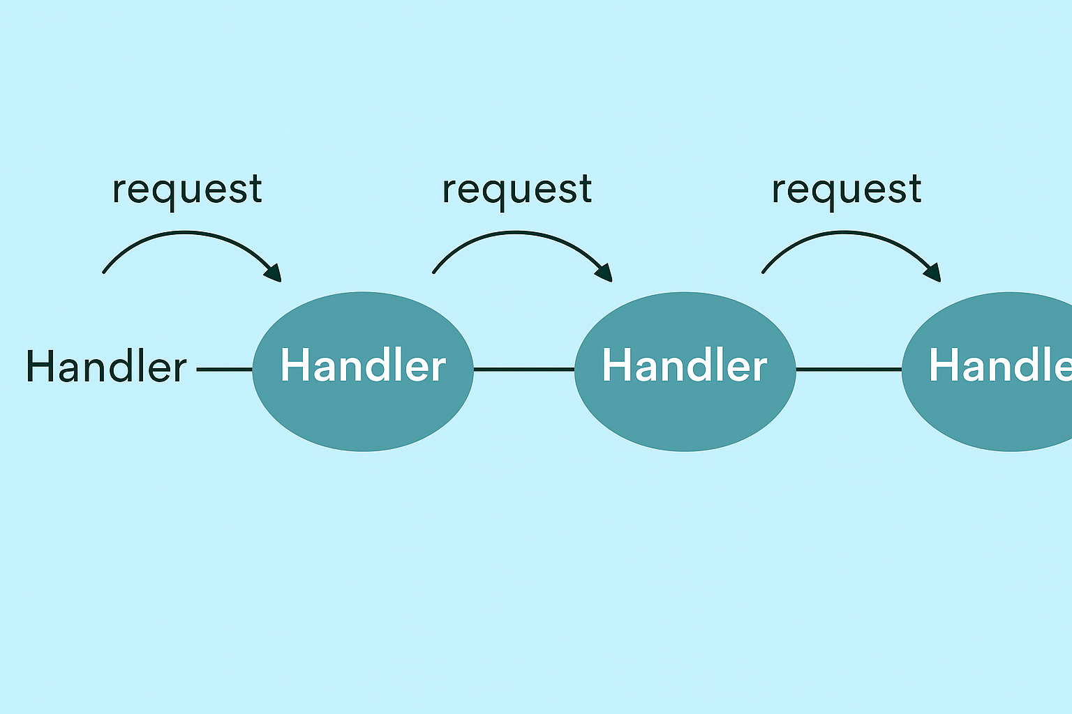
Chain of Responsibility

Slide 6
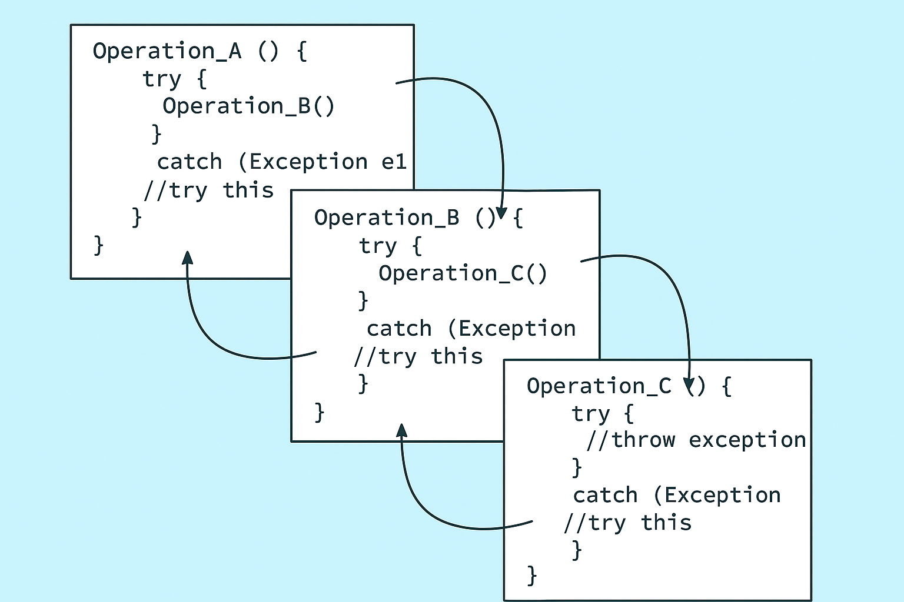

Slide 7
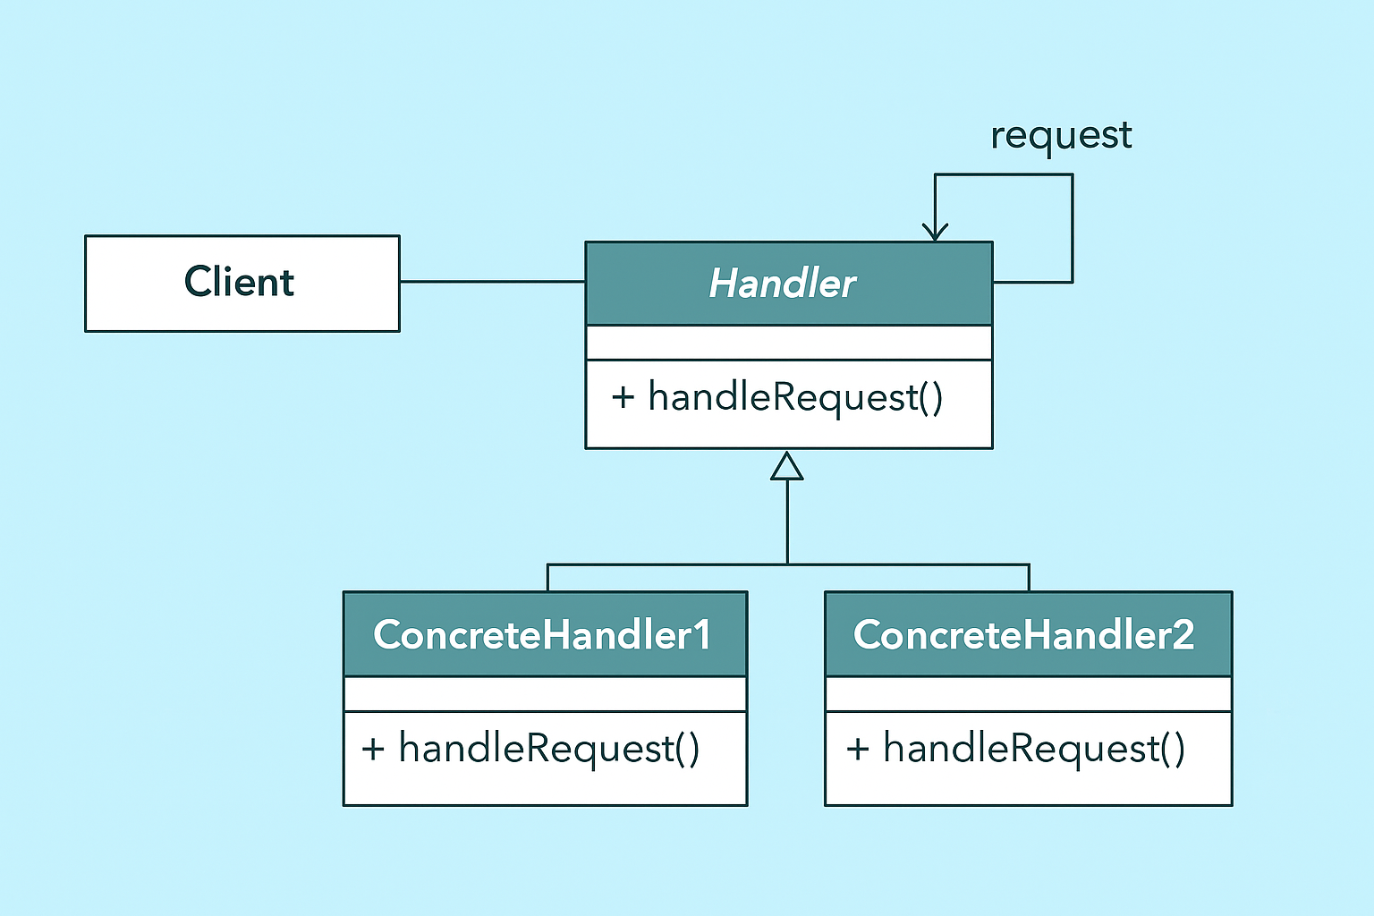

Slide 8
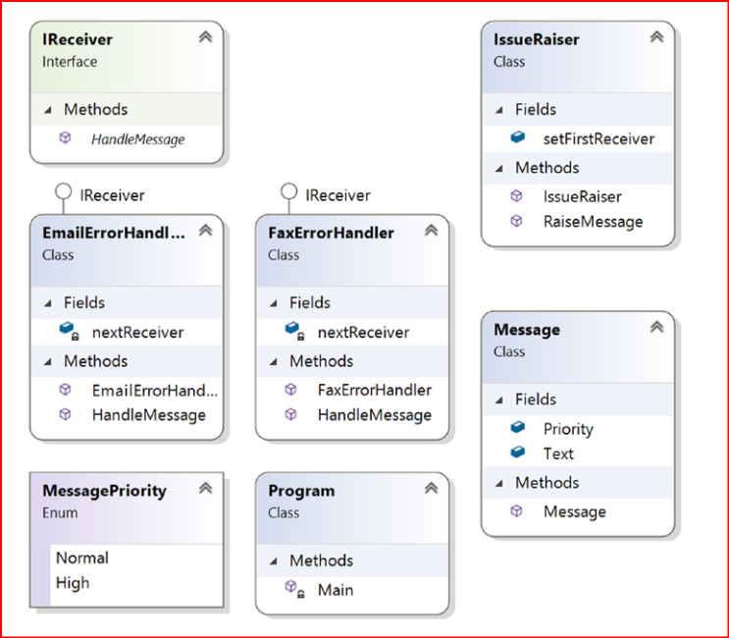

Slide 9
Setting up the Priorities
Performance
Accuracy
Less complex

Slide 10
Applications
Email Spam detectors
Medical Testing
Troubleshooting
Classifier Systems
Event Handling Frameworks
Security Systems

Slide 11
What are the advantages of using the Chain of Responsibility design pattern?
You have more than one object to handle a request.
The nodes of the chain can be added or removed dynamically. Also, you can shuffle their order.
A handler does not need to know how the next handler in the chain will handle the request. It can focus on its own handling mechanism only.
In this pattern, you are decoupling the senders (of requests) from the receivers.
Can improve High Availability (HA) & Disaster Recovery (DR)

Slide 12
What are the challenges associated with using the Chain of Responsibility design pattern?
There is no guarantee that the request will be handled because you may reach at the end of chain but have not found any explicit receiver to handle the request.
Debugging becomes tricky with this kind of design.
Unnecessary handlers may lead to inefficiency.
Priority can be set.
Bypassing the handlers depending on the information received.

Slide 13
Reflective Questions
How does the Chain of Responsibility pattern promote flexibility in assigning responsibilities among objects, and what trade-offs might it introduce?
In what real-world software scenarios could the Chain of Responsibility be more effective than using conditional statements (e.g., if-else chains)?
How might improper implementation of the Chain of Responsibility lead to performance issues or debugging difficulties, and how can these be mitigated?

